Slide 1
JAVA – Functions (Methods)

Slide 2
What is a Function (Method)?
A function in Java is a block of code that performs a specific task.
In Java, functions are called Methods.
✔ A method executes only when it is called ✔ Helps in code reusability ✔ Improves program readability and structure

Slide 3
Why Do We Need Methods?
Avoids repetition of code
Makes program modular
Improves maintainability
Reduces complexity
Supports Object-Oriented Programming

Slide 4
General Syntax of a Method
returnType methodName(parameters) {
// body of method
}
Eg:
void displayMessage() {
System.out.println("Welcome to Java Programming");
}

Slide 5
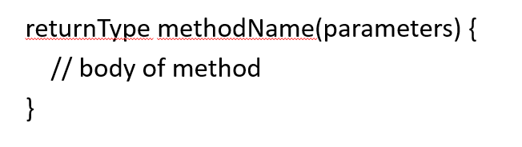
Parts of a Method
Component | Description
returnType | Value returned by method
methodName | Name used to call the method
parameters | Input values
method body | Code to execute

Slide 6
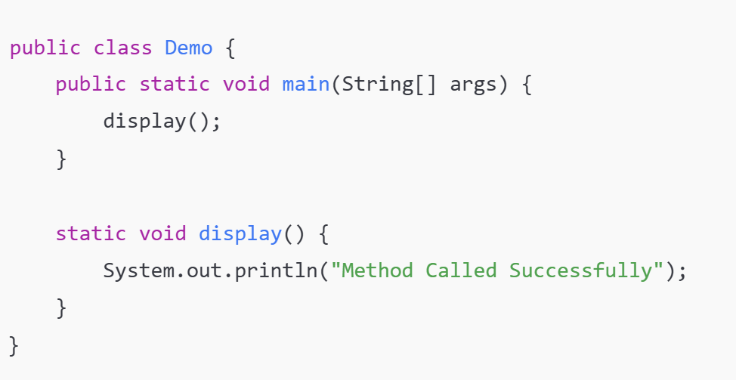
Calling a Method
A method executes only when it is called.

Slide 7
Types of Methods in Java
Method without parameters & return value
Method with parameters
Method with return value
Method with parameters and return value

Slide 8
What is a Return Value in Java?
A return value is the result sent back by a method after it finishes executing.
A return value is the value that a method sends back using the keyword: return;
static int add(int a, int b) {
return a + b;
}
Ex: int result = add(10, 20);
add(10, 20) is called
Inside the method → 10 + 20 = 30
return 30; sends value back
30 is stored in result
add() is the method
int is the return type
a + b is the return value

Slide 9
Why Do We Need Return Values?
✔ To use results later ✔ To perform further calculations ✔ To avoid printing directly inside methods ✔ To make code reusable
Types of Return Values
Returning an Integer
static int square(int n) {
return n * n;
}
Returning Boolean
static boolean isEven(int n) {
return n % 2 == 0;
}
Returning a Decimal Value
static double average(int a, int b) {
return (a + b) / 2.0;
}
Returning String
static String greet(String name) {
return "Hello " + name;
}

Slide 10
Method Without Return Value (void)
If a method does not return anything, use void.
static void display()
{
System.out.println("Hello");
}
➡ Cannot use return value;
➡ Only return; is allowed (optional)
Feature | return | void
Sends value back | Yes | No
Used in method | Yes | Yes
Can store result | Yes | No
Important
✔ Return type must match the value ✔ A method can return only one value ✔ Code after return is not executed ✔ return ends method execution

Slide 11
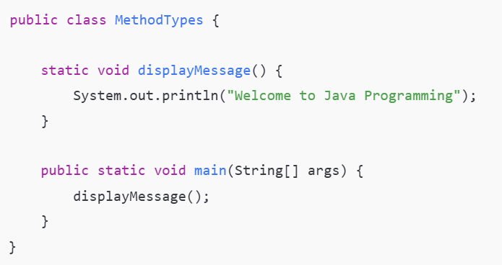
1. Method WITHOUT Parameters & WITHOUT Return Value
Does not take input
Does not return output
Just performs an action
No parameters inside ()
void → no return value
Used for simple display tasks

Slide 12
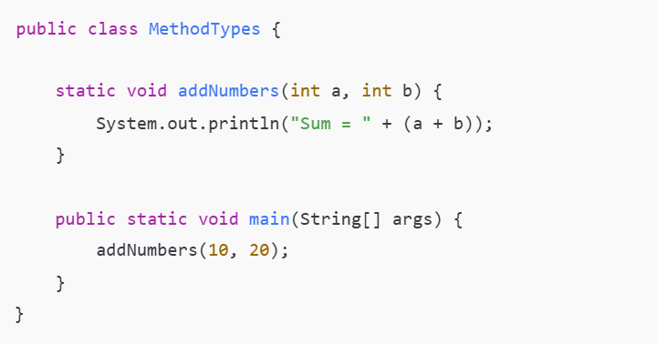
2: Method WITH Parameters & WITHOUT Return Value
Takes input values
Does not return any value
Parameters are passed ✖ No return value

Slide 13
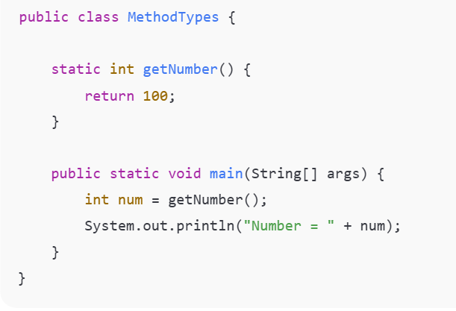
3: Method WITHOUT Parameters & WITH Return Value
Does not take input
Returns a value
Difference from Type 2:
✔ Returns a value ✖ No parameters

Slide 14
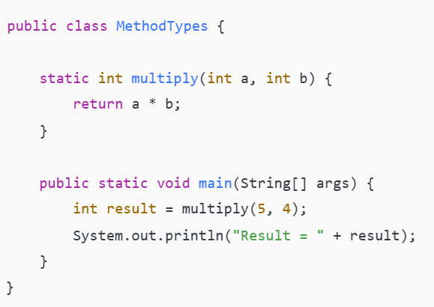
Method WITH Parameters & WITH Return Value
Takes input
Returns output
Difference from Type 3:
✔ Takes parameters ✔ Returns value

Slide 15
STATIC KEYWORD IN JAVA
What is static?
static means belongs to the class, not to the object.
A static method can be called without creating an object.
The main() method is always static because JVM must call it directly.

Slide 16
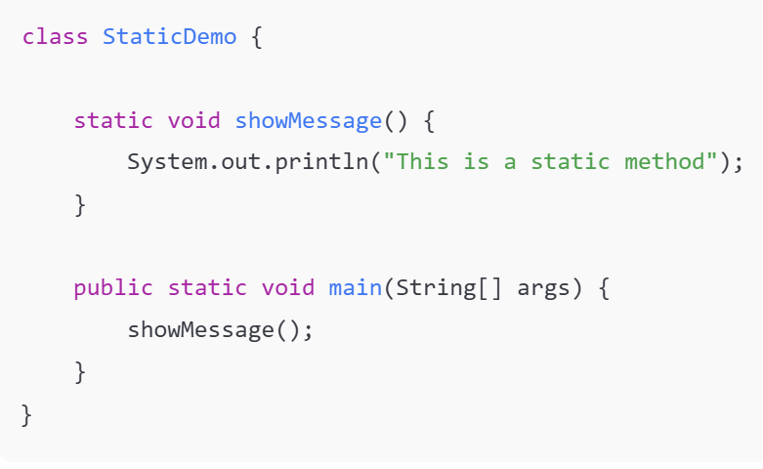

Line | Explanation
static void showMessage() | Declares a static method
showMessage(); | Called directly without creating object
main() | Entry point of Java program
✔ No object is required because both methods are static.

Slide 17
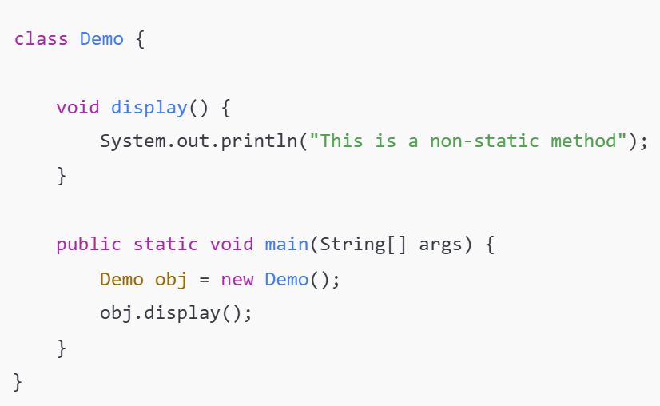
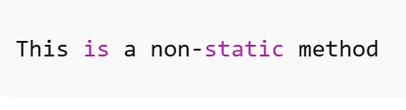
NON-STATIC METHOD (OBJECT REQUIRED)
Non-static methods belong to an object
You must create an object to call them

Slide 18
Statement | Meaning
Demo obj = new Demo(); | Object creation
obj.display(); | Method call using object
display() | Non-static method
Without object → non-static methods cannot be accessed

Slide 19
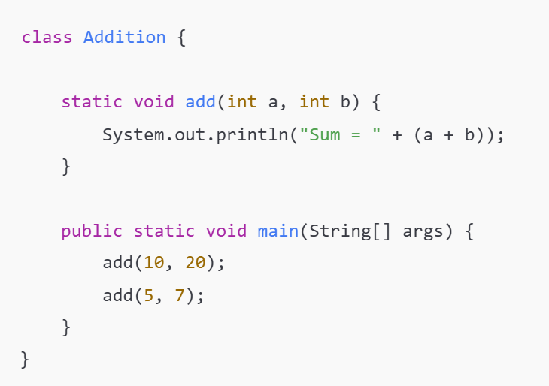
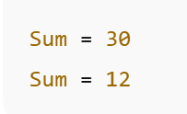
METHOD WITH PARAMETERS
Parameters allow data to be passed to a method.
Helps make programs dynamic.
a and b are parameters
Values are passed during method call
Same method reused multiple times

Slide 20
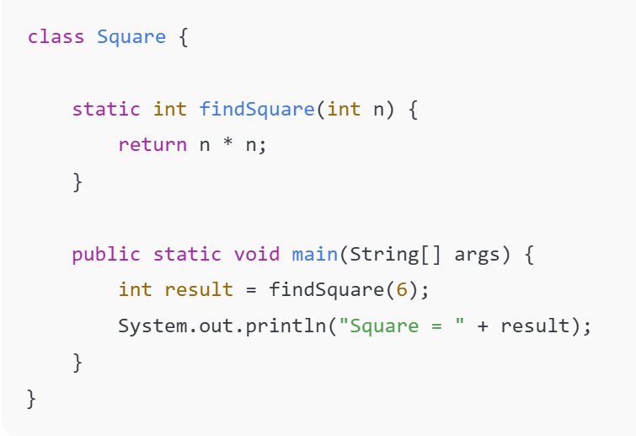

METHOD WITH RETURN VALUE
A method can return a value using return
Returned value must match return type
Step | Description
findSquare(6) | Function call
return n*n | Sends value back
result | Stores returned value

Slide 21
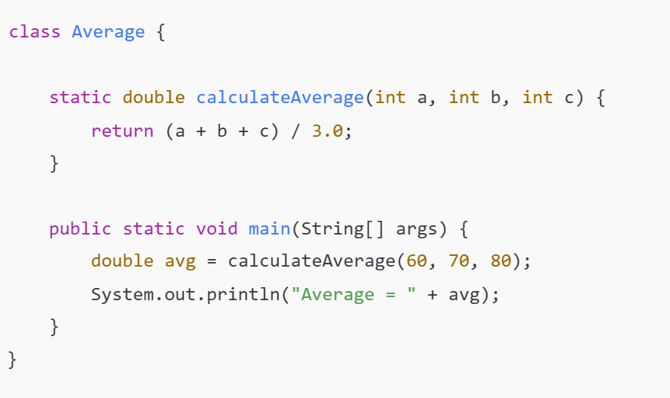
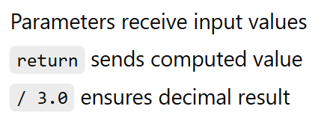
METHOD WITH PARAMETERS & RETURN VALUE
Average = 70.0

Slide 22
METHOD OVERLOADING
Same method name with:
Different number of parameters OR
Different data types

Slide 23
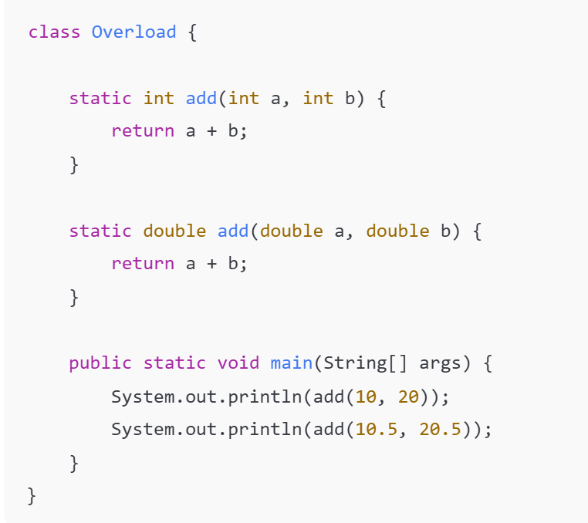
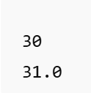
Java decides which method to call based on parameters
This is compile-time polymorphism

Slide 24
Exercise
Problem 1: Electricity Bill Calculation System
An electricity board charges consumers based on the following slabs:
Units Consumed | Rate per Unit
First 100 units | ₹1.50
Next 100 units | ₹2.50
Above 200 units | ₹4.00
Write a Java program using functions to calculate and display the total electricity bill.
Requirements
Create a method:
static double calculateBill(int units)
The method should return the total bill amount.
In main(), take input from the user and print the bill.

Slide 25
Problem 2: ATM Transaction Simulation
Design a Java program to simulate basic ATM operations using functions.
Operations:
Check Balance
Deposit Money
Withdraw Money
Rules
Initial balance = ₹10,000
Withdrawal amount should not exceed balance
Deposit and withdrawal should update balance
static double checkBalance(double balance)
static double deposit(double balance, double amount)
static double withdraw(double balance, double amount)
Program Flow
Display menu
User selects option
Appropriate method is called
Updated balance is shown

